Slide 1
Vaccines, Variants, IHME
IHME. COVID-19 Results Briefing. Iran (Islamic Republic of). May 21, 2021.
https://www.healthdata.org/sites/default/files/covid_briefs/142_briefing_Iran_Islamic_Republic_of.pdf

Slide 2
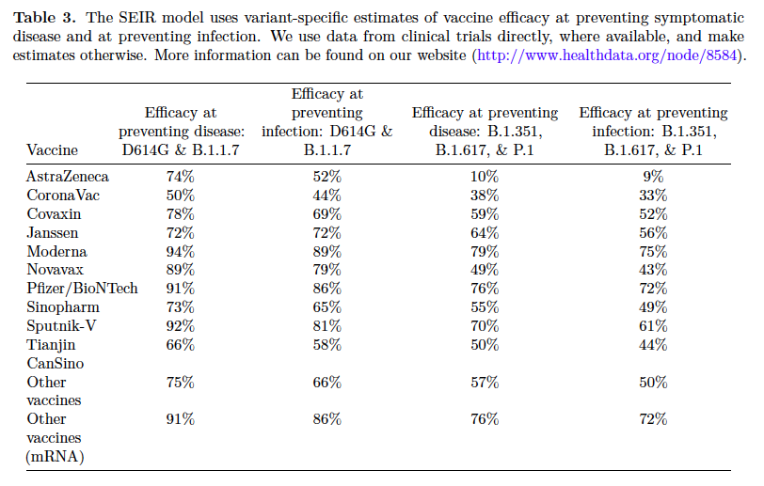
Replaced ancestral & UK
S. Africa, IND, Brazil
B.1.1.7 (UK), B.1.351 (S. Africa), P1 (Brazil), B.1.617 (India), D614G (The ancestral form of severe acute respiratory syndrome coronavirus 2 (SARS-CoV-2) that emerged from China has now been largely replaced by strains containing the mutation D614G (Asp614-to-Gly) in the viral spike protein. [Science 18 Dec 2020: Vol. 370, Issue 6523, pp. 1464-1468

